Slide 1

RUNGTA COLLEGE OF DENTAL SCIENCES & RESEARCH
TITLE OF THE TOPIC-
CEPHALOMETRICS
DEPARTMENT OF ORTHODONTICS AND DENTOFACIAL ORTHOPAEDICS

Slide 2
Specific learning Objectives
CORE AREAS | DOMAIN | CATEGORY
TYPES OF CEPHALOGRAM | AFFECTIVE | NICE TO KNOW
USES | COGNITIVE | NICE TO KNOW
LANDMARKS | COGNITIVE | MUST KNOW
LINES AND PLANES | COGNITIVE | MUST KNOW
ANALYSIS | COGNITIVE | MUST KNOW
ERRORS | PSYCHOMOTOR | NICE TO KNOW
RECENT ADVANCES | AFFECTIVE | DESIRE TO KNOW

Slide 3
CONTENT:-
PART I
INTRODUCTION
TYPES OF CEPHALOGRAM
USES
LANDMARKS
LINES AND PLANES
ANALYSIS
PART II
ANALYSIS
ERRORS
RECENT ADVANCES
SUMMARY

Slide 4
DOWN’S ANALYSIS
IT CONSISTS OF 10 PARAMETERS OF WHICH FIVE ARE SKELETAL AND FIVE ARE DENTAL

Slide 5
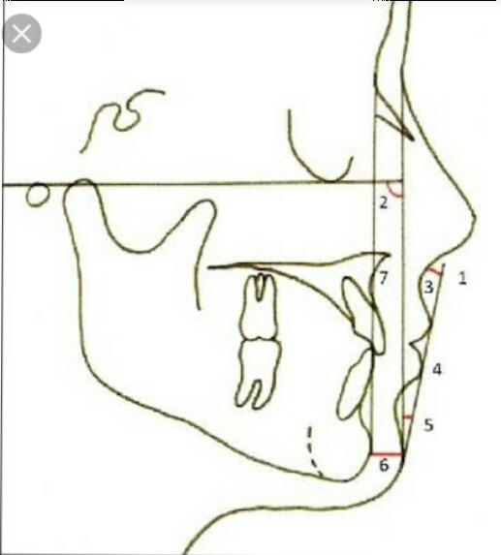
SKELETAL PARAMETERS
1) FACIAL ANGLE
* Inferior angle formed by intersection of NASION - pogonion plane And F.H plane
* Average value is 87.8 degree (82 to95 degrees)
*Significance: Indication in anteroposterior positioning Of mandible in relation to lower face
* Increased in skeletal class III with prominent chin
# increased in skeletal class II

Slide 6
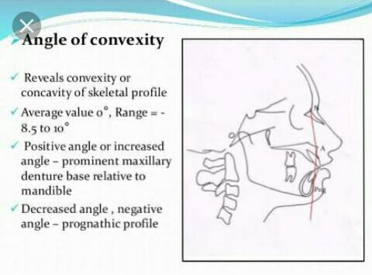
2) ANGLE OF CONVEXITY
NASION - point A to point A -pogonion
Average value is 0 degree

Slide 7
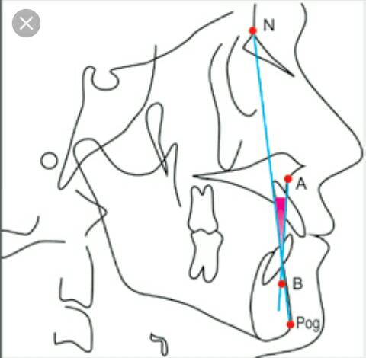
3) A-B PLANE ANGLE point A –point B to Nasion – pogonion
.Average value: -4.6 degrees ( -9 to 0 degrees ) significance: Indication of maxillomandibular relationship in relation to facial plane

Slide 8
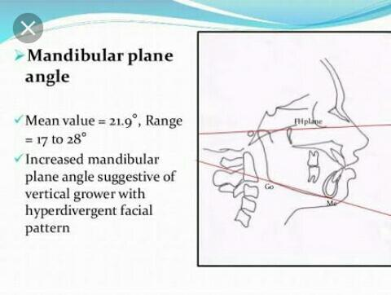
4) MANDIBULAR PLANE ANGLE
* Intersection of mandibular plane with F.H plane
* average value :21.9 degree( 17 to 28 degrees)

Slide 9
5) Y –AXIS
Line joined by connecting sella -GNATHION with the F H – plane
The mean value is 59 degree(53 to 63 degrees)
Indicates growth of an individual

Slide 10
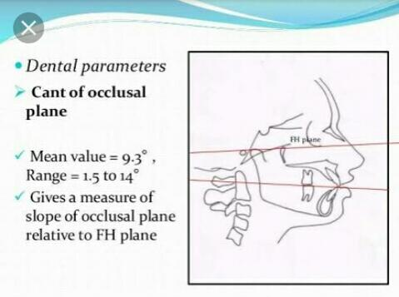
Dental Parameters
1) CANT OF OCCLUSAL PLANE
*Occlusal plane to f.h plane
Average value – 9.3 degree(1.5 degree to 14 degree)
Gives a measure of slope of Occlusal plane to f h plane

Slide 11
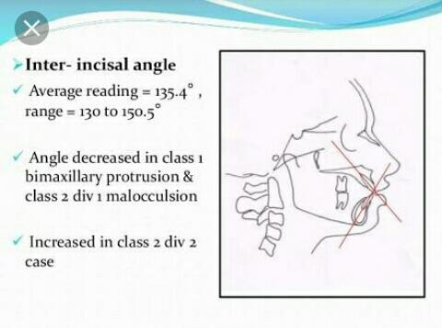
2) INTER INCISAL ANGLE
Angle between long axis of upper and lower incisors
Average value : 135.4 degrees(130 to 150.5 degrees)
Increased in class l bimaxillary protrusion

Slide 12
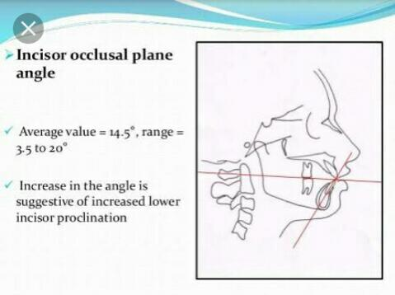
3) INCISOR OCCLUSAL PLANE ANGLE
This is the inside inferior angle formed by the intersection of long axis of lower central incisors
*And the Occlusal plane And is read as a plus or minus deviation from a right angle
* Average value – 14.5 degrees (3.5 to 20 degrees)
*increase in angle is a suggestive of increased lower incisors Proclination

Slide 13
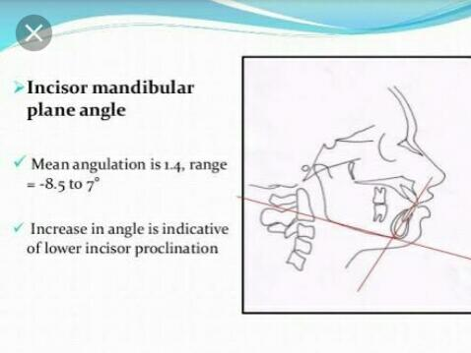
4) INCISOR MANDIBULAR PLANE ANGLE
Angle is formed by intersection of long axis of lower incisors to mandibular plane
average value -1.4 degree (-8.2 to7 degrees)
an increase in value is suggestive of increased lower incisors Proclination

Slide 14
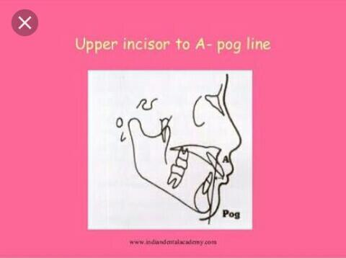
5) UPPER INCISORS To A- pog line
This is a linear measurements between INCISAL edges of maxillary central incisors And the line joining point A to POGONION
Average value:2.7 mm (-1 to 5 mm)
the measure us more in patients with upper central incisors Proclination

Slide 15
STEINER ANALYSIS
The Steiner Analysis Is Divided Into Three Parts
1) SKELETAL
2) DENTAL
3) SOFT TISSUE ANALYSIS

Slide 16
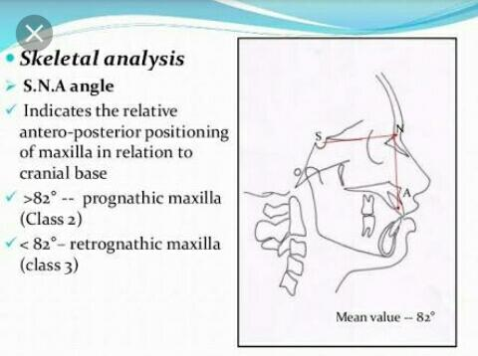
SKELETAL ANALYSIS
1) S.N.A. ANGLE
It is the angle formed by the intersection of s.n plane and line joining Nasion and point A
The mean value is 82 degrees
A larger than normal value indicates that the maxilla is Prognathic while. Smaller value is retrognathic maxilla

Slide 17
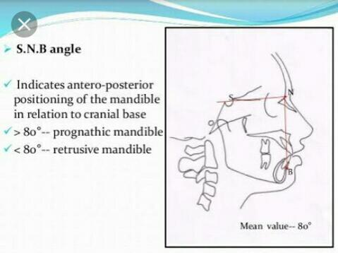
2) S.N.B angle
It is the angle between s.n plane and line joining Nasion to point B
Its average value is 80 degrees
An increase in angle indicates a Prognathic mandible whereas a less than normal indicates retrusive mandible

Slide 18
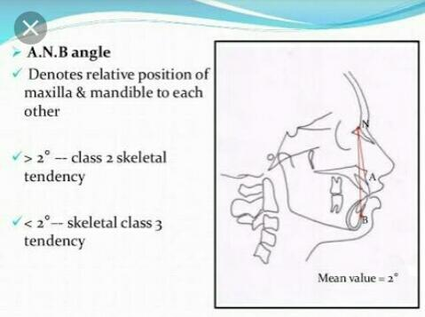
    3) A .N.B angle
This angle is formed by the intersection of lines joining Nasion to point A and NASION to point B
The mean value is 2 degree
An increase in value is indicative of class II skeletal tendency while a angle less than normal or a negative angle is suggestive of skeletal class III relationship

Slide 19
4) MANDIBULAR PLANE ANGLE
It is the angle formed by s.n plane to the Mandibular plane
The average value is 32 degree
A lower angle is indicative of horizontal growing face while a increased angle suggests a vertical growing individual

Slide 20
5) OCCLUSAL PLANE ANGLE
It is formed between the Occlusal plane and the SN plane
Mean value is 14.5 degree
This angle indicates the relation of the Occlusal plane to the cranium and face

Slide 21
DENTAL ANALYSIS
1) UPPER INCISORS TO N-A (angle )
It is the angle formed by the intersection of the long axis of the upper central incisors and the line joining Nasion to point A
The mean value is 22 degree
The angle indicates the relative inclination of the upper incisors
An increased angle is seen in class ll division l malocclusion.

Slide 22
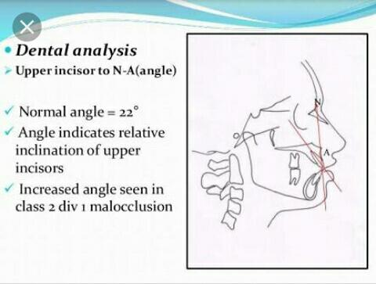
2) UPPER INCISORS TO N-A ( linear )
It is a linear measurements between the LABIAL surface of the upper central incisors and the line joining Nasion to point A
Normal value is 4 mm
Increased in proclined upper incisors

Slide 23
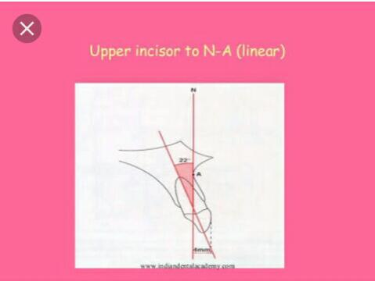

Slide 24
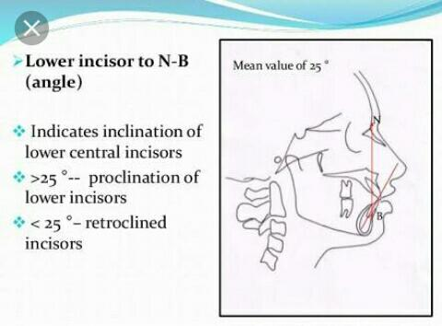
3) LOWER INCISOR TO N-B angle
This angle is formed between the N-B plane and the long axis of lower incisor
Mean value Is 25degree
An increased value indicates proclination of lower incisors whereas a decreased values indicates upright or retroclined lower incisors

Slide 25
4) LOWER INCISOR TO N-B (linear)
It is the linear distance between the LABIAL surface of lower central incisors and the line joining Nasion to point B
The mean value is 4mm
An increase in measurement indicates proclined lower incisors

Slide 26
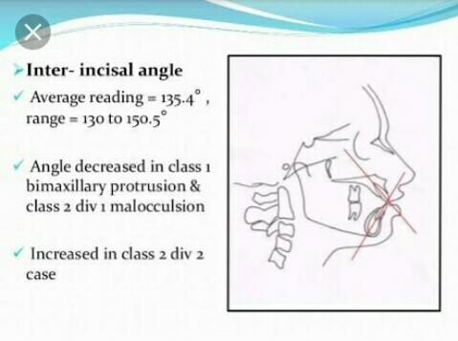
5) INTER- INCISAL ANGLE
This is the angle formed between the long axis of the upper and lower central incisors
Mean value is 130 to 131 degrees
A reduced inter incisor angle is associated with a class II division l malocclusion
A larger than normal angle is seen in class II division 2 malocclusion

Slide 27
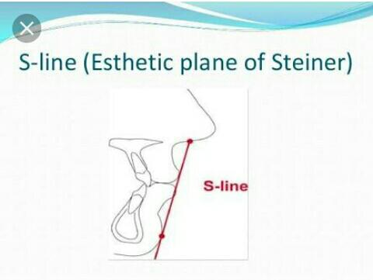
SOFT TISSUE ANALYSIS
S- LINE
According to Steiner the lips in a well balanced face should touch a line extending from the soft tissue contour of the chin to the middle of an ‘S’ formed by the lower border of the nose

Slide 28
If the lips are located beyond the line then the lips is protrusive and is a convex profile
If the lips are behind this line they are said to be retrusive and the patient may have concave profile

Slide 29
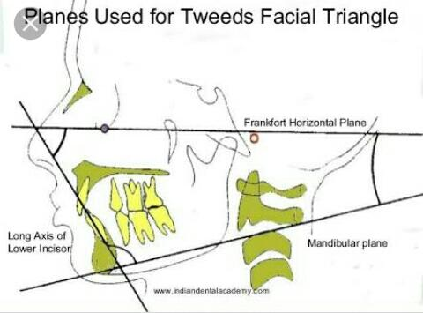
TWEED ANALYSIS
The Tweed Analysis makes use of three planes that form a diagnostic triangle . the planes used are
A) Frankfort horizontal plane
B) Mandibular plane
C) Long axis of lower incisors

Slide 30
1) Frankfort Mandibular plane angle ( FMPA)
It is the angle formed by the intersection of the Frankfort horizontal plane with the Mandibular plane .
The mean value is 25 degree

Slide 31
2) INCISOR MANDIBULAR PLANE ANGLE (IMPA)
It is the angle formed by the intersection of the long axis of the lower incisors with the Mandibular plane
The mean value is 90 degree
It indicates the inclination of the lower incisor

Slide 32
3) FRANKFORT MANDIBULAR INCISOR ANGLE (FMIA)
It is the angle formed by the intersection of the long axis of the lower incisor with the F.H .plane
The mean value is 65 degree

Slide 33
THE WITS APPRAISAL
The wits appraisal is a measure of the extent to which the maxilla and the mandible are related to each other in the antero posterior or sagittal plane angle.
The wits appraisal is used in cases where the ANB angle is considered not so reliable due to the factoris such as position of the nasion and rotation of there jaws.
A functional occlusal plane is drawn through the overlapping cusps pf the first premolars and first molars.

Slide 34
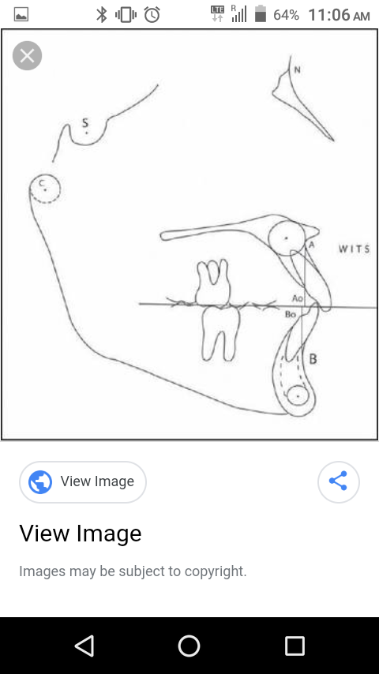

Slide 35
ERRORS
RADIOGRAPHIC PROJECTION ERRORS
ERRORS WITHIN THE MEASURING SYSTEM
ERRORS IN LANDMARK IDENTIFICATION

Slide 36
RECENT ADVANCEMENT
Computers are now widely used in cephalometrics
The computerized cephalometrics system allow for quick digitizing of the landmarks and generation of various cephalometric analyses
Computerized cephalometry provides speed in addition to reliability
The advantages of this system include:
Easy storage and retrieval of cephalometric tracing and values
Integration of cephalometric registrations with in an office management computrised system
Combination of the cephalometric data with other patient record including photographs.

Slide 37
RECENT ADVANACEMENT
NEMOCEF SOFTWARE
DOLPHIN SOFTWARE

Slide 38
SUMMARY
Introduced in 1931 by BROADBENT and HOFRATH
It is a standardized method of production of skull radiographs
Cephalograms can be of two types LATERAL & FRONTAL
It is a valuable tool in the identification and classification of skeletal and dental anomalies

Slide 39
REFERENCES
Textbook of Orthodontics – Gurkeerat Singh, Jaypee Brothers; 2nd Edition
Orthodontics – The Art and Science, S.I Bhalajhi, AryaMedi Publishing; 7th Edition
Textbook of Orthodontics – Sridhar Premkumar, Elsevier; 1st Edition
Orthodontics: Diagnosis and Management of Malocclusion and Dentofacial Deformities – O.P Kharbanda, Elsevier; 1st Edition

Slide 40
Question & Answer Session

